Slide 1
Analysis of Video Game Sales and User Scores Using Regression Discontinuity
Kyle VanHatten
ECON 438
Essay 3 Presentation

Slide 2
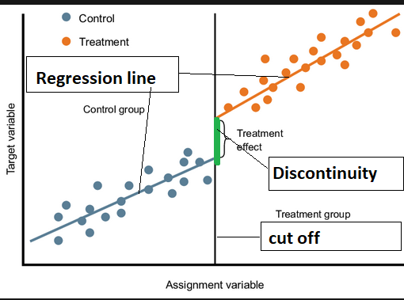
Objective:
Explore relationships between critic scores, user scores, and global sales on the Metacritic review site.
Apply Regression Discontinuity Analysis (RDA) to detect jumps at 50% and 75% critic review scores.
Refine data by removing outliers and identifying patterns in specific subsets (e.g., high sales, recent games).

Slide 3
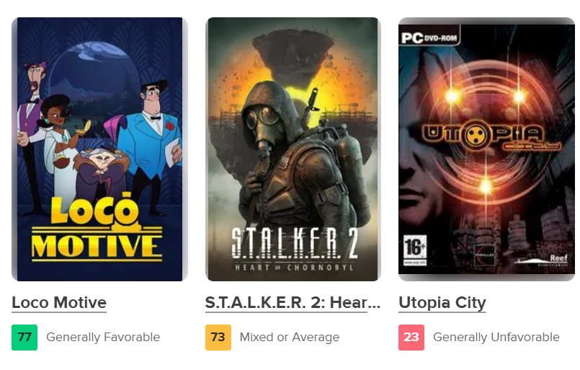
Metacritic Review Coloring (Games)
Green: 75+
Yellow: 50-74
Red: 0-49

Slide 4
Main Idea
Perception Shift at Key Thresholds
Minimal quality difference (e.g., 74 vs. 75) may create a perception bias due to color changes.
Critics Review First
Critics often submit reviews earlier, potentially influencing user opinions
A waiting period for user reviews (and NOT critics) was implemented in 2020; however, this policy is not reflected in the dataset.

Slide 5
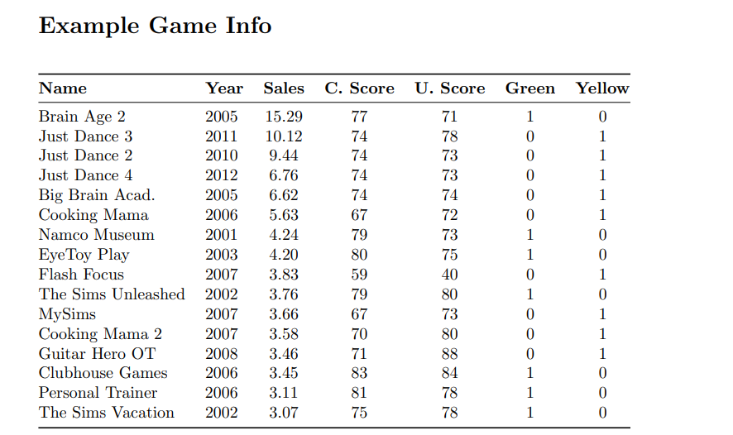
Slide 3: Data Overview
Dataset:
Source: Publicly available Kaggle dataset.
Sample Size: 3,680 games, ranging in release year from 1980-2016
Data Cleaning:
Removed missing values.
Standardized user scores to match critic scores (/100).
Ensured proper column types for consistency.

Slide 6
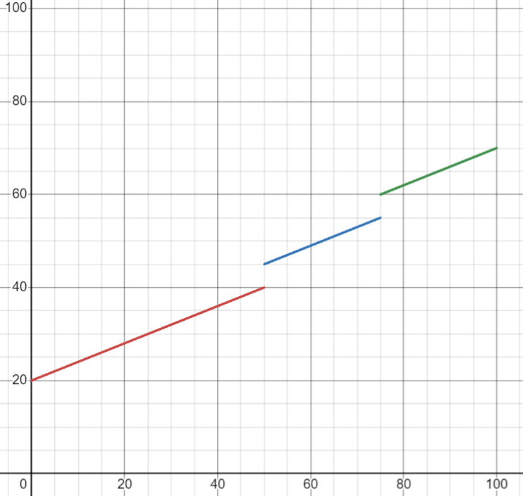
Treatment Variables
Categorization Based on Critic Score
Green Treatment: critic_score ≥ 75
Yellow Treatment: 50 ≤ critic_score
Created subsets for Regression Discontinuity (RD) Analysis at 75 and 50 thresholds.

Slide 7
Methods / Code
Methods
Regression Discontinuity (RD) Models for User Score / Global Sales
Simple RD Model: Assumes fixed slopes on either side of the threshold.
Robust RD Model: Allows slopes to differ across thresholds.
Subset Analysis
Re-ran Robust RD using:
Jittered Critic Scores: Evaluates model robustness to minor score variations.
Filtered Data: Excludes low user/critic review counts.
Outlier Removal: Removes extreme review scores.
Log-Transformed Sales: Analyzed the impact of critic scores on log-transformed global sales, accounting for skewness in sales data.

Slide 8
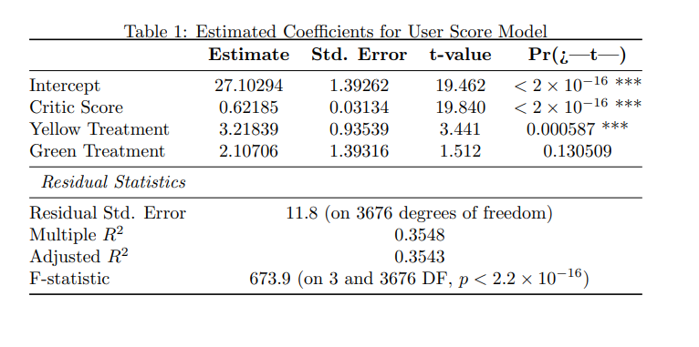
Standard RD Results: User Scores

Slide 9
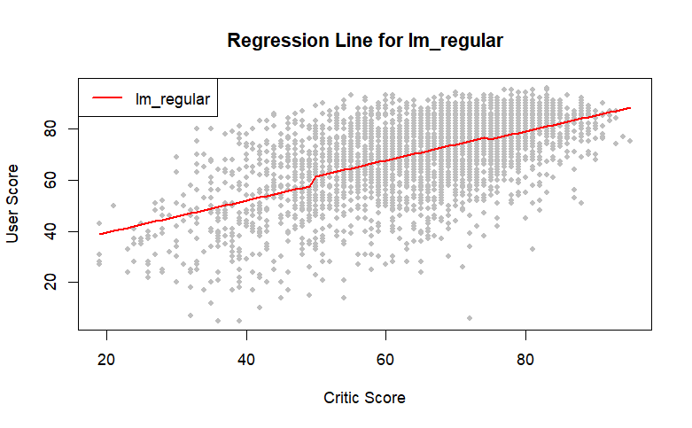
Standard RD Results: User Scores

Slide 10
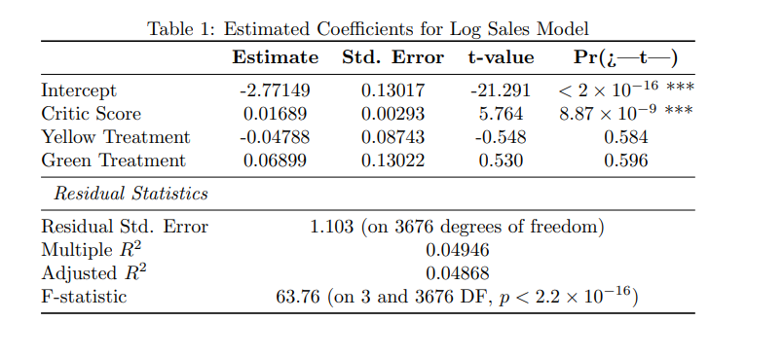
Standard RD Results: Global Sales (Millions)

Slide 11
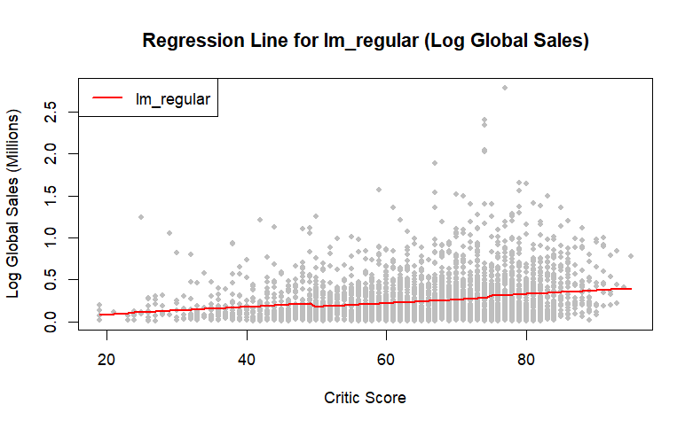
Standard RD Results: Global Sales (Millions)

Slide 12
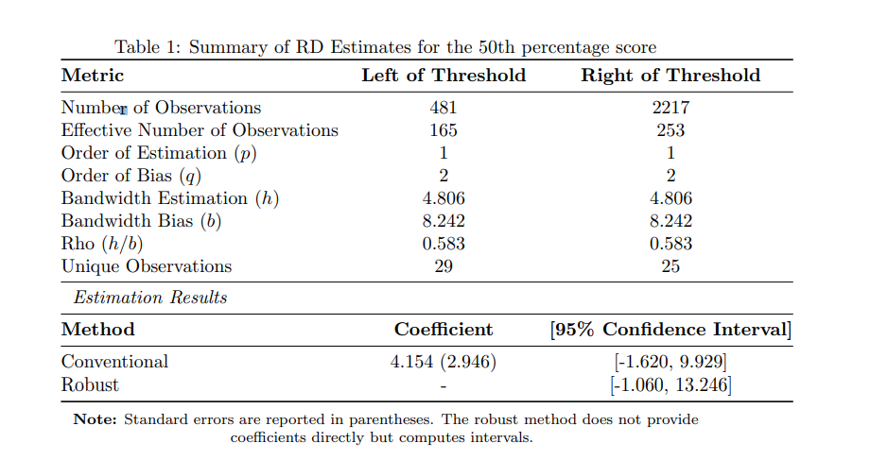
Robust RD Results: User Scores

Slide 13
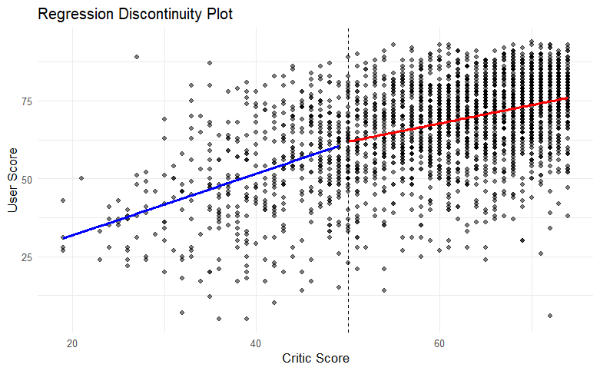
Robust RD Results: User Scores

Slide 14
Challenges and Future Work
Review-Bombing: Potential manipulation of user scores due to coordinated efforts.
Expanding Scope: Include movies or other media for comparative analysis alongside games.
Statistical Significance: Address the general lack of statistically significant results in certain analyses.
Global Impact:
Although critic and user scores are interconnected, their influence on global sales may be limited.
Many game buyers might not consult Metacritic scores before purchasing.

Slide 15
Thank You

